Slide 1
Facade Pattern
Lecture 15

Slide 2
Facade
“Provide a unified interface to a set of interfaces in a collection of subsystems.
Facade defines a higher-level interface that makes the subsystems easier to use.”

Slide 3
Motivation
“Common design goal is to minimize the communication and dependencies between subsystems. One way to achieve this goal is to introduce a facade object that provides a single, simplified interface to the more general facilities of a subsystem.”
With façade clients don't have to be concerned with exactly which object in a subsystem they're dealing with. They just call methods on the facade in blissful ignorance.

Slide 4
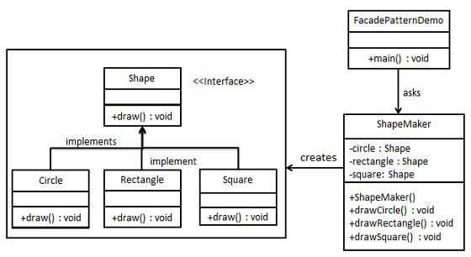
Implementation

Slide 5
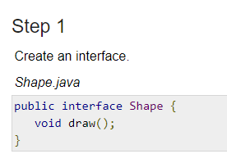

Slide 6
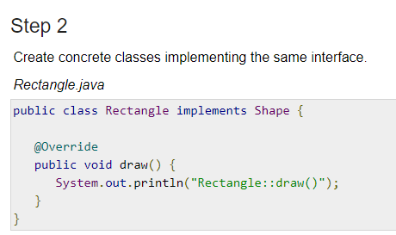

Slide 7
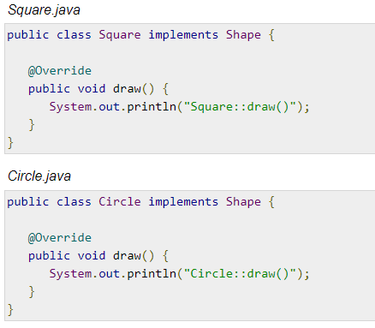

Slide 8
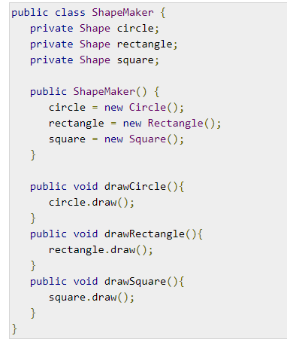

Slide 9
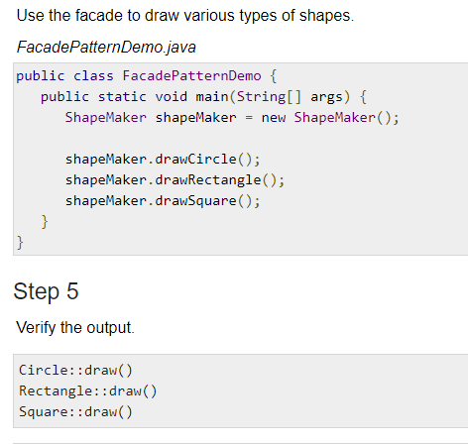

Slide 10
References
https://www.tutorialspoint.com/design_pattern/facade_pattern.htm

